Slide 1
Bellabeat case study
How Can a Wellness Technology Company Play It Smart?
~Siddhi Behere

Slide 2
AGENDA
Primary goal
​Data Overview
Insights
​Recommendations
Questions

Slide 3
PRIMARY GOAL
To gain insight into how consumers are using their smart devices so the insights that will be discovered will help guide marketing strategy for Bellabeat.

Slide 4
Data Overview
Data source: https://www.kaggle.com/datasets/arashnic/fitbit
Sample size: 33
The data is Reliable, Original, Comprehensive and Cited.
Data Limitations:
Limited sample size
Collected in 2016
Limited descriptive data(age, sex, lifestyle, etc.)

Slide 5
Insights

Slide 6
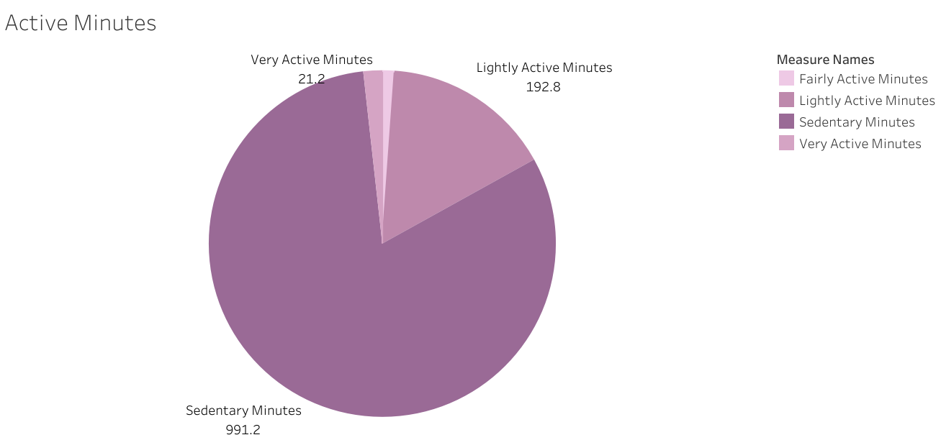
991.2 minutes on an average are sedentary whereas only 34.8 minutes on an average in very active and fairly active state combined.

Slide 7
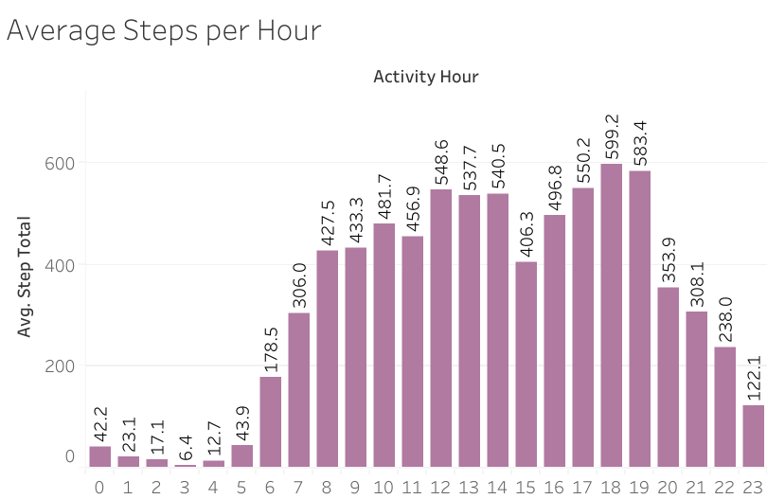
The peak hours are 12PM to 2PM and 5PM to 7PM

Slide 8
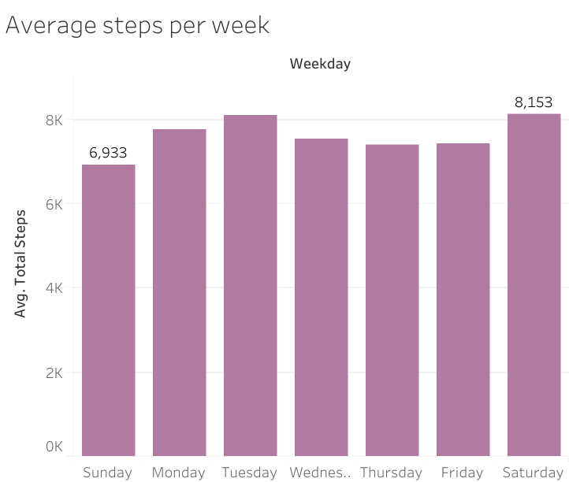
Sunday can be considered a lazy day

Slide 9
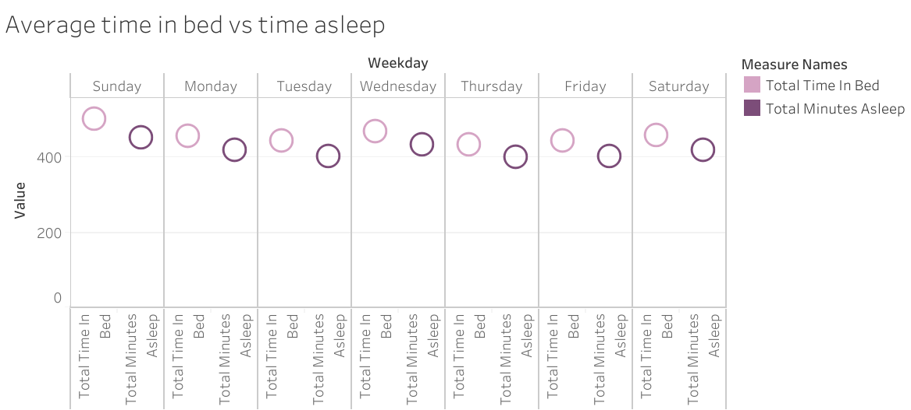

Slide 10
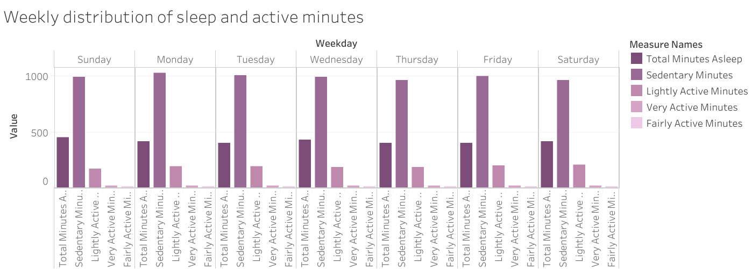

Slide 11
Recommendations
Bellabeat time product can vibrate after sensing prolonged Sendentary minutes
BELLABEAT APP CAN HAVE SOME VIDEOS OF YOGA INSTRUCTORS OR FITNESS TRAINERS ON SHORT EXERCISES THAT CAN KEEP THE USERS ACTIVE AND FIT
BELLABEAT APP CAN HAVE A STREAK SYSTEM. WHENEVER USER COMPLETES HER DAILY STEPS AND SHORT EXERCISES , A NOTIFICATION
LIKE “STREAK POINTS ADDED” CAN POP UP.
THESE STREAK POINTS CAN BE LATER REDEEMED ON BELLABEAT PRODUCTS/
MEMBERSHIPS
ALONG WITH THE STREAK SYSTEM, TOP THREE USERS WITH HIGHEST STEP COUNT WILL RECEIVE SOME GIFT VOUCHERS/GIFT CARDS FROM BELLABEAT. IN THIS WAY, USERS WILL BE ENCOURAGED TO EXERCISE.
BELLABEAT APP CAN ALSO POP UP SOME POSITIVE NOTIFICATIONS LIKE “KEEP IT UP” TO KEEP THE USERS MOTIVATED

Slide 12
Questions?
Siddhi Behere
siddhibehere2003@gmail.com

